Slide 1
Lecture 6
Event Studies

Slide 2
Event Study Analysis
Definition: An event study attempts to measure the valuation effects of a corporate event, such as a merger or earnings announcement, by examining the response of the stock price around the announcement of the event.
One underlying assumption is that the market processes information about the event in an efficient and unbiased manner.
Thus, we should be able to see the effect of the event on prices.

Slide 3
Prices around Announcement Date under EMH
Stock Price
Overreaction
Efficient reaction
Underreaction
0
+t
-t
Announcement Date

Slide 4
The event that affects a firm's valuation may be:
  1) within the firm's control, such as the event of the announcement of a stock split.
  2) outside the firm's control, such as a macroeconomic announcement that will affect the firm's future operations in some way.
Various events have been examined:
  mergers and acquisitions
  earnings announcements
  issues of new debt and equity
  announcements of macroeconomic variables
  IPO’s
  dividend announcements.
  etc.

Slide 5
Technique mainly used in corporate finance (not economics).
Simple on the surface, but there are a lot of issues.
Long history in finance:
  First paper that applies event-studies, as we know them today: Fama, Fisher, Jensen, and Roll (1969) for stock splits.
  Today, we find thousands of papers using event-study methods.
This is also known as an event-time analysis to differentiate it from a calendar time analysis.

Slide 6
Classic References
Brown and Warner (1980, 1985): Short-term performance studies
Loughran and Ritter (1995): Long-term performance study.
Barber and Lyon (1997) and Lyon, Barber and Tsai (1999): Long-term performance studies.
Eckbo, Masulis and Norli (2000) and Mitchell and Stafford (2000): Potential problems with the existing long-term performance studies.
Ahern (2008), WP: Sample selection and event study estimation.
Updated Reviews:
M.J. Seiler (2004), Performing Financial Studies: A Methodological Cookbook. Chapter 13.
Kothari and Warner (2006), Econometrics of event studies, Chapter 1 in Handbook of Corporate Finance: Empirical Corporate Finance.

Slide 7
Event Study Design
The steps for an event study are as follows:
– Event Definition
– Selection Criteria
– Normal and Abnormal Return Measurement
– Estimation Procedure
– Testing Procedure
– Empirical Results
– Interpretation

Slide 8
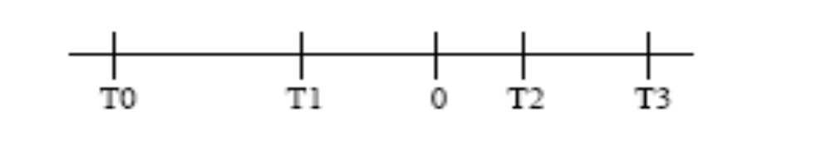
Time-line
The time-line for a typical event study is shown below in event time:
- The interval T0-T1is the estimation period
- The interval T1-T2 is the event window
- Time 0 is the event date in calendar time
- The interval T2-T3 is the post-event window
- There is often a gap between the estimation and event periods

Slide 9
Issues with the Time-line:
  - Defintion of an event: We have to define what an event is. It must be unexpected. Also, we must know the exact date of the event. Dating is always a problem (WSJ is not a good source -leakage).
  - Frequency of the event study: We have to decide how fast the information is incorporated into prices. We cannot look at yearly returns. We can’t look at 10-seconds returns. People usually look at daily, weekly or monthly returns.
  - Sample Selection: We have to decide what is the universe of companies in the sample.
  - Horizon of the event study: If markets are efficient, we should consider short horizons –i.e., a few days. However, people have looked at long-horizons. Event studies can be categorized by horizon:
  - Short horizon (from 1-month before to 1-month after the event)
  - Long horizon (up to 5 years after the event).

Slide 10
  Short and long horizon studies have different goals:
  Short horizon studies: how fast information gets into prices.
  Long horizon studies: Argument for inefficiency or for different expected returns (or a confusing combination of both)

Slide 11
Models for measuring normal performance
We can always decompose a return as:
R_{i;t} = E[R_{i;t} |X_{t}] + ξ_{i,t} ,
where X_{t} is the conditioning information at time t:
In event studies, ξ_{i;t} is called the “abnormal” return.
Q: Why abnormal? It is assumed that the unexplained part is due to some “abnormal” event that is not captured by the model.
In a sense, we want to get close to a natural experiment.
  There is an exogenous (unanticipated) shock that affects some stocks.
  We want to compare the returns of those stocks around the announcement to others that are not affected.

Slide 12
Definition of “Normal” Returns: We need a benchmark (control group) against which to judge the impact of returns.
  There is a huge literature on this topic.
  From the CAPM/APT literature, we know that what drives expected stock returns is not exactly clear.
  This is precisely what we need to do in event studies: We need to specify expected returns (we just call them “normal” returns).
  Note that if we are looking at short horizon studies, we can assume that expected returns do not change. No problem, here.
  If we are looking at long horizons, we know that expected returns change. Big problem. We have to be careful.
  In long horizon studies, the specification of expected returns makes a huge difference, because small errors are cumulated. There is no easy way out of this problem.

Slide 13
Statistical or economic models for normal returns?
Statistical models of returns are derived purely from statistical assumptions about the behavior of returns -i.e., multivariate normality.
- Multivariate normality produces two popular models:
1) constant mean return model and
2) the market model.
Note: If normality is incorrect, we still have a least squared interpretation for the estimates.
Actually, we only need to assume stable distributions. See Owen and Rabinovitch (1983).

Slide 14
Economic models apply restrictions to a statistical model that result from assumed behavior motivated by theory -i.e., CAPM, APT.
  If the restrictions are true, we can calculate more precise measures of abnormal returns.
  CLM: “there seems to be no good reason to use an economic model.”

Slide 15
Popular Statistical Models
Constant mean return model
For each asset i, the constant mean return model assumes that asset returns are given by:
R_{i,t} = E[R_{i;t} |X_{t}] + ξ_{i,t} , where
E[R_{i;t} |X_{t}] = μ,
E[ξ_{i,t}] = 0 and Var[ξ_{i,t}] = σ_{ξ,i}²
Brown and Warner (1980, 1985) find that the simple mean returns model often yields results similar to those of more sophisticated models because the variance of abnormal returns is not reduced much by choosing a more sophisticated model.

Slide 16
Market model (MM) (the most popular in practice)
For each asset i, the MM assumes that asset returns are given by:
R_{i,t} = E[R_{i;t} |X_{t}] + ξ_{i,t} , where
E[R_{i;t} |X_{t}] = α_{i} + β_{i} R_{m,t} ,
E[ξ_{i,t}] = 0 and Var[ξ_{i,t}] = σ_{ξ,i}²
In this model R_{m,t} is the return on the market portfolio, and the model’s linear specification follows from an assumed joint normality of returns.
  - Usually a broad-based stock index is used as the market portfolio (S&P 500 or the CRSP EW or CRSP VW).
  - When β_{i} = 0, we have the constant mean return model.
  - The MM improves over the constant mean return model: we remove from ξ_{i,t} changes related to the return on the market portfolio.
  - The benefit of using the MM depends on the R² of the regression. (The higher the R² , the greater the power to detect abnormal performance.)

Slide 17
Other Models for Expected Returns
CAPM
E[R_{i;t}|X_{t}] – r_{f,t} = β_{i} (E[R_{m,t} |X_{t}] – r_{f,t}),
Fama and French (1993) (FF) 3 factor model
  E[R_{i;t}|X_{t}] - r_{f},_{t} = a_{i} + b_{1i}(E[R_{m}|X_{t}]- r_{f})_{t} + b_{2i}SML_{t} + b_{3i} HML_{t}
SML: returns on small (Size) portfolio minus returns on big portfolio
HML: returns on high (B/M) portfolio minus returns on low portfolio
Note: More factors can be easily added to this ad-hoc model, for example, a momentum factor –see, Carhart (1997) .

Slide 18
Sorts
Suppose that there are two factors that affect returns: Size and (B/M). We do not know whether there is a stable or linear relationship as the one specified in the FF model.
What to do.
  - Sort all returns in the universe (CRSP) into 10 deciles according to size.
  - Conditional on size, sort returns into ten deciles according to BM. (This gives us 100 portfolios.)
  - Compute the average return of the 100 portfolios for each period. This gives us the expected returns of stocks given the characteristics.
  - For each stock in the event study:
  1) Find in what size decile they belong.
  2) Then, find in what B/M decile they belong.
  3) Compare the return of the stock to the corresponding portfolio return.
  4) Deviations are called “abnormal” return.

Slide 19
Fact: Sorts give more conservative results. If we use the FF method, we tend to find huge abnormal returns, while with the sorts, we do not.
Note:
  - Results change if we sort first by B/M and then size (not good).
  - Results change if we sort according to other characteristics.
  - Data-mining problem: We choose a sorting method that works after many trials. Out of 100 trials, there must be five that works, at the 5% level. Pre-testing problem, again!

Slide 20
Estimation of Abnormal Returns
There are several ways of estimating “abnormal” returns. In addition to specifying expected returns, there is the issue of how to cumulate returns. There are two methods:
1. Cumulated Abnormal Returns (CARs)
AR_{i,t} = R_{i,t} - E[R_{i;t} |X_{t}]
CAR^{i}_{t,;t+K} = Σ_{k} AR_{i,,t+k}
Note: CARs are like prices -they are prices if we have log returns.
If we fix K; we can compute the variance of the CAR. Then, under certain conditions:
CAR^{i}_{t,;t+K} ~ N(0,σ²_{i,,t+k})

Slide 21


Sometimes we are looking at only several categories (j = 1,..,J ) (IPO and non-IPO firms). Suppose there are N₁,…,N_{J} firms in each category.
Then, the CAR for each category is:
The advantage of aggregating across assets is immediately clear:

Slide 22
2. Buy and Hold Abnormal Returns (BHAR)
Several economists (Ritter (1991), Barber and Lyons (1997), Lyons et al. (1999) have argued that CARs are not appealing on economic grounds. BL propose to use buy-and-hold returns, defined as:
AR_{i,t} = R_{i,t} - E[R_{i;t} |X_{t}]
BHAR^{i}_{t,;t+K} = Π_{k} (1+AR_{i,,t+k})
Difference between CAR and BHAR: arithmetic versus geometric sums.
As in the case of CARs, we can aggregate BHAR. The variance also is reduced for the same reasons.

Slide 23
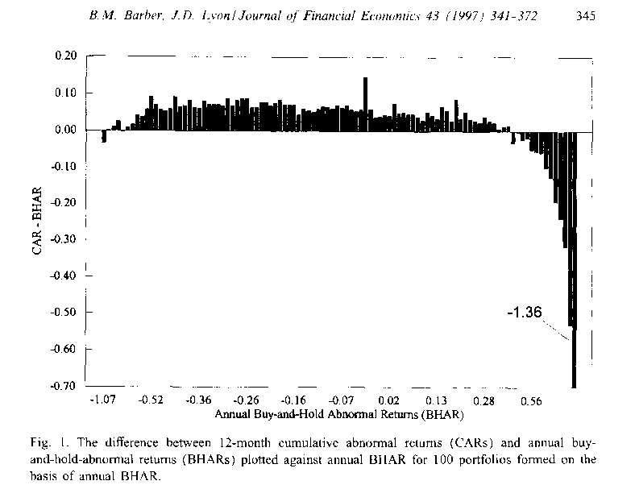

Slide 24
Barber and Lyons (1997) relate BHAR and CAR in a regression:
BHAR_{t} = -0.013 + 1.041 CAR_{t} + e_{t}
CARs are a biased predictor of long-run BHAR. (There is a measurement bias.)
Question: Which method to use: BHAR or CAR?
- For short horizons, both are very similar.
- For long horizons, BHAR seems conceptually better.
- BHAR tend to be right skewed (bounded from below!)

Slide 25
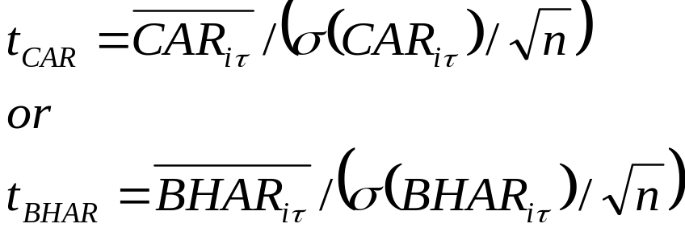
Testing
Null Hypothesis: Event has no impact on returns –i.e., no abnormal mean returns, unusual return volatility, etc.
The focus is usually on mean returns.
Parametric Test.
Traditional t-statistics (or variations of them) are used:
Appealing to a CLT, a standard normal is used for both tests.

Slide 26
Non-Parametric Tests
Advantage: Free of specific assumptions about return distribution.
Intuition: Let p = P(CAR_{i} ≥ 0), then under the usual event studies hypothesis, we have H₀: p ≤ 0.5 against H1 : p > 0.5. (Note if distribution of CAR_{i} is not symmetric, we need to adjust the formulation of p.)
Popular Tests: Sign Test (assumes symmetry in returns) and Rank Test (allows for non-symmetry in returns). See Corrado (1989).
  - Example: Sign Test
  Let N+ be the number of firms with CAR>0, and N the total number of firms in the sample. Then, H₀ can be tested using
  J = [(N+/N) − 0.5] 2 N^{1/2} ~ ^{A} N(0,1)
Usually, non-parametric tests are used as a check of the parametric tests.

Slide 27
Econometric Problems
There are many econometric problems in event studies. The problems can be divided into two categories:
(i) Misspecifications of expected returns (wrong inference due to bias in the estimates of abnormal returns).
(ii) Non-random sample, leading to non-normal distributions (wrong inference due to standard error calculations).

Slide 28
Bootstrap
Non-normality (actually, an unknown distribution F₀(x)!) and limited number of observations can be a serious problem for testing. Bootstrapping can help to make inferences with good size.
Bootstrapping: We estimate properties of an estimator by measuring those properties by sampling from an approximating distribution. Choice for an approximate distribution: the empirical distribution -EDF or F_{n}(x).
Note: The EDF is a good choice. The Glivenko-Cantelli theorem that F_{n}(x) →F₀(x) as n → ∞ uniformly over x almost surely.
Then, we can get approximate critical and p-values for an estimator by sampling from the EDF. This is the essential nature of the “bootstrap.”
• If the sample is a good indicator of the population, the bootstrap works.

Slide 29
Under mild regularity conditions, the bootstrap yields an
approximation to the distribution of an estimator or test statistic
The distribution is at least as accurate as the approximation obtained from first-order asymptotic theory.
Note: The bootstrap substitutes computation for mathematical analysis if calculating the asymptotic distribution of an estimator is difficult.
Advantages: Simplicity, no parametric assumptions needed. Consistent estimates.
Disadvantage: It’s an approximation, though asymptotically consistent. In small or bad samples, the bootstrap will not work well.
Keep in mind the key bootstrap analogy:
The population is to the sample
as the sample is to the bootstrap samples

Slide 30
Intuition
We are interested in the behavior of the sample statistic W under H₀. The CDF of W depends on the unknown F₀(x).
The bootstrap estimates the CDF of W by carrying out a Monte Carlo simulation in which random samples are drawn from F_{n}(x) (We treat the sample as if it were the population.)
We take B random samples with replacement from the sample data set. (We are creating pseudo-samples.)
Each of these random samples will be the same size n as the original set, the samples will be similar, but not be the same. Thus, each re-sample randomly departs from the original sample. (We treat the pseudo-samples as realizations from the true population.)
We calculate the statistic W under H₀ for each resample. W will vary slightly from the original sample statistic.

Slide 31
Now, we have a relative frequency histogram of W under H₀, which will help us to understand its distribution.
Basic Bootstrap Setup
The bootstrap method consists of five basic steps:
(1) Get a sample of data size n from a population.
(2) Take a random sample of size n with replacement from the sample.
(3) Calculate the statistic of interest W under H₀ for the random sample.
(4) Repeat steps (2) and (3) a large number B times (say, 10,000).
(5) Create a relative frequency histogram of the B statistics of interest W under H₀ (all estimated W have the same probability.)
As B approaches infinity the bootstrap estimate of the statistic of interest will approach the population statistic.

Slide 32
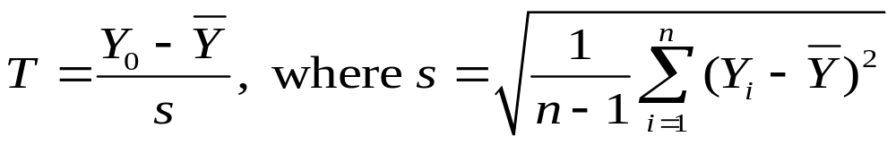
• Simple Example: Outlier detection
We have a random (iid) sample {Y₁,…,Y_{n}}. We observe a high y₀.
Q: How far into the tail of the typical distribution is y₀?
The null hypothesis is y₀ belongs in the distribution.
With unknown μ and s, we use the statistic:
The distribution of the statistic depends on the distribution of the RVs: Ῡ and s, which we assume unknown. (Or given a small sample size, CLT results may provide very poor finite sample approximation.)

Slide 33
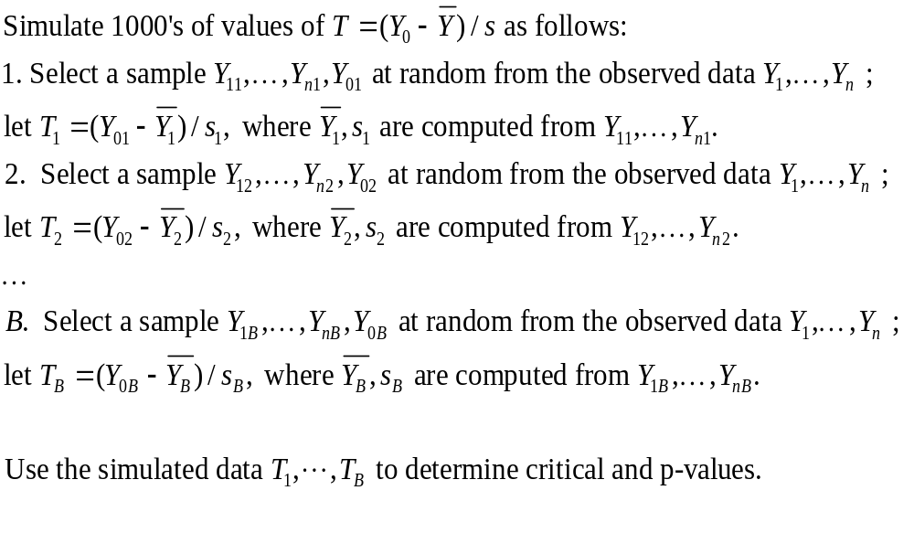
Inferences can be made based on the following “simulation”:

Slide 34
Example: Mutual Fund performance
We have N returns from a Mutual Fund. We want to estimate Jensen’s alpha (α_{i}).
Model for expected performance: Market (CAPM) Model
E[R_{i;t} – r_{f} |X_{t}] = α_{i} + β_{i} (R_{m,t} – r_{f} )
H₀ (no abnormal returns): α_{i} = 0. Calculate standard t-test, say t.
Bootstrap to establish a p-value for the t-statistic.
(1) Estimate R_{i;t} – r_{f} = α_{i} + β_{i} (R_{m,t} – r_{f} ) + ε_{it} (Keep (a_{i}, b_{i} and e_{it})
(2) Generate the simulated data under H₀, using the residuals only:
R_{i,t} – r_{f} = 0 + b_{i} (R_{m,t} – r_{f}) + e_{it} (Do this N times.)
(3) Estimate the model using the generated data.
  (R_{i,t} – r_{f}) = a₁ + b₁(R_{m,t} – r_{f}) + ξ_{it} (Calculate t-test, say τ*)
(4) Repeat (2) and (3) B Times. The bootstrap p-value of the t-test is the proportion of B samples yielding a τ* ≥ t.

Slide 35
Note: This is a conditional bootstrap, since we are conditioning on R_{m,t}. We are really bootstrapping the marginal distribution of R_{i}|R_{m}.
In many situations, it is possible to do an unconditional bootstrap. In step 2), we can draw the residuals (e_{i}) and the explanatory variable (x_{i}).
The unconditional bootstrap is more conservative. It can have the interpretation of a test for spurious correlation.
(In a framework with dependent x_{i}’s, like in time series cases, the unconditional bootstrap will not work well.)

Slide 36
• Bootstrap Inference for event studies: Steps
(1) Obtain an event sample of size n. Say n=2,000.
(2) Draw a sample of 2,000 observations with replacement from the returns assuming no event.
(3) Computations: Calculate expected returns, abnormal returns, CARs.
(4) Repeat (2) and (3) a large number of times, say 5,000. We have 5,000 CARs computed under the null of no effect. We generate a distribution.
(5) Compare the computed CAR from the event study to the bootstrapped distribution. If in the tails, reject the null of no effect.

Slide 37
Ignoring serial dependence in the draws can severely flawed inferences: If the bootstrap is applied to dependent observation, the re-sampled data will not preserve the properties of the original data set.
Event samples are not always random samples. Voluntary event firms are unlikely independent observations. In particular, major corporate events cluster through time by industry:
=> positive cross-correlation of abnormal returns (standard errors need to be corrected. Traditional t-tests tend to overstate).
Mitchell and Stafford (2000) find no abnormal returns of SEO, mergers and share repurchases, once they correct for the positive cross-correlations of event firm abnormal returns, while a standard bootstrap finds significant abnormal returns.

Slide 38
Block bootstrap (accounts for dependences in returns or residuals):
  - Build blocks that are long enough to remove most of the dependency structure.
  - Recall that the dependence does not mean that the observations are independent when separated by more than 2 observations.
  - Suppose we have, n=200 observations, we can break it up into 20 non-overlapping blocks of 10 each, then draw the blocks at random, with replacement. (Overlapping blocks can also be used, but less accurate. Hall, Horowitz, and Jing (1995).)
  There is a method called “Tapered block bootstrap” to smooth the effects of boundaries between neighbored blocks.

Slide 39
Sieve Bootstrap (dependent data with iid innovations): AR(q) process.
X_{t} = Σ_{j} ρ_{j} X_{t-j} + ε_{t}, E[ε_{t}] = 0, ε_{t} ~ iid
  - The parameters ρ can be estimated by OLS or Yule-Walker equations (get p). Get residuals, e.
  - The AR order q is usually estimated using AIC.
  - Bootstrap resamples {X_{t}*, t>p) drawing e_{t} with replacement. Create X_{t}* using the AR process:
  X_{t}*= Σ_{j} p_{j} X_{t-j}* + e_{t}.
  (In practice, we set X_{t-p+1}*= …= X₀* = Mean of X -or zero if X demeaned. It’s also common to demean the residuals e.)

Slide 40
References:
General Boostrap: Efron (1979, 1982, 2003), Wu (1986).
Block Bootstrap: Politis and Romano (1994), Paparoditis and Politis (2001, 2002).
Sieve (Time Series) Bootstrap: Franke and Kreiss (1992).
Review Book: Horowitz (2001) in Handbook of Econometrics, Vol. 5.
Efron and Tibshirani (1993).
Good reference (Time Series): Berkowitz and Kilian, Econometric Reviews (2000).

Slide 41
Explaining CARs
Once “abnormal” returns are found, it is common to try to explain CAR, or find whether CAR are correlated with some economic variables. That is, we want to run the regression:
CAR_{i,t} = α + δ X_{i,t} + υ_{i,t}
usually, X_{i,t} are firm characteristics.
We can run this regression in the cross-section.
Main problem with this regression. The OLS assumption E[X_{i,t} υ_{i,t} ]=0 might be violated. => Inconsistent estimates!
(Endogeneity is the usual suspect in the cases where the event is within the firm’s control.)

Slide 42
Consider the following:
AR_{i,t} =R_{i,t} - α - δ R_{m,t} - φX_{i,t}
where X are some firm characteristics.
People use the X characteristics to correctly anticipate returns (or events). For example, if banks are announcing write-offs, you might expect that the banks that have not announced them, will do so.
(Moreover, banks will try to make the announcement at a time that is most favorable. This introduces a truncation bias –it introduces a non-linearity in the model.)
If we include X in the regression, then
E[AR_{i,t},X_{i,t}] = 0.
It makes no sense to run: AR_{i,t} = α + γX_{i,t} + ε_{i,t}

Slide 43
If we exclude X; when it should be included, then we get (suppose that R_{m,t}and X_{i,t} are not correlated):
AR*_{i,t} = R_{i,t} - α - δ R_{m,t}
= AR_{i,t} + φ X_{i,t}
Now, we run: AR*_{i,t} = α + γX_{i,t} + ε*_{i,t}
Then,
E[ε*_{i,t} ,X_{i,t}] = E[ε_{i,t} X_{i,t}] + φ E[X_{i,t}X_{i,t}] ≠0!
Prabhala (1997) explains why this problem might not be too severe.
Q: What might be a potential solution?

